Slide 1
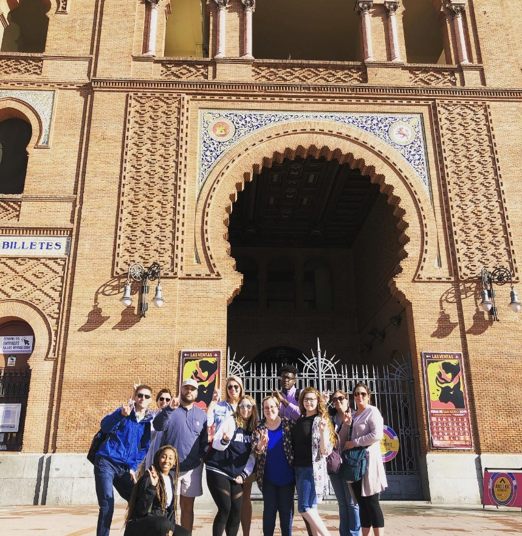
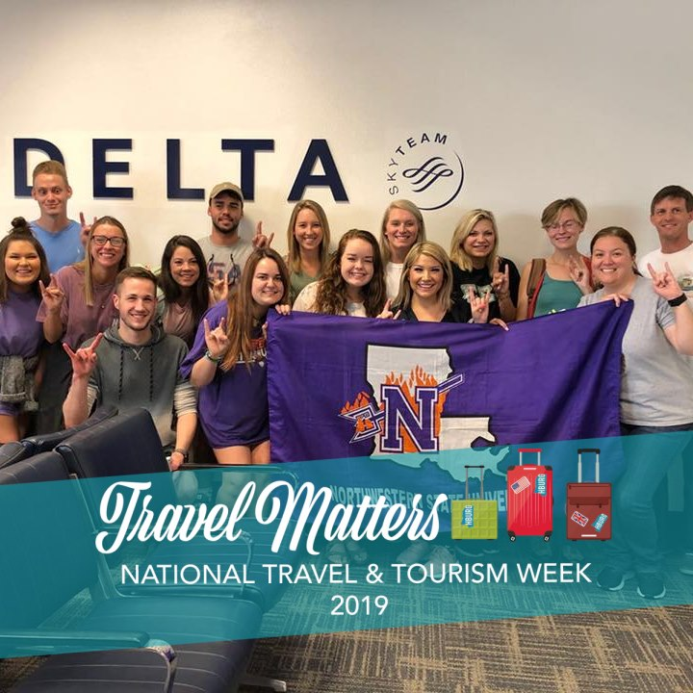
Ireland, Italy & Greece
International Study Tour
Summer 2020
May 11 – May 26

Slide 2
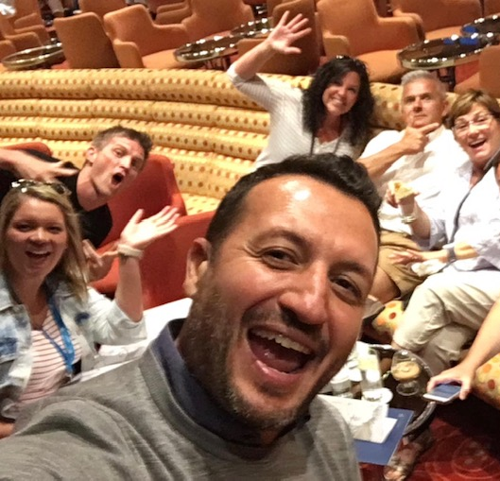
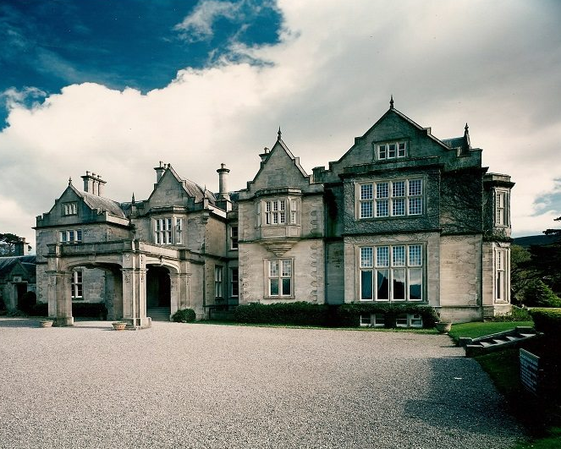
Itinerary
Day 1: Depart from New Orleans
Fly to Ireland
Day 2: Hello Shannon- Meet your tour director, travel to Killarney & check into hotel
Day 3: Ring of Kerry
Ring of Kerry excursion
Sheep farm visit (March to October)

Slide 3
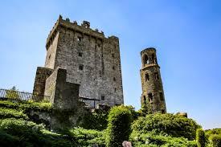
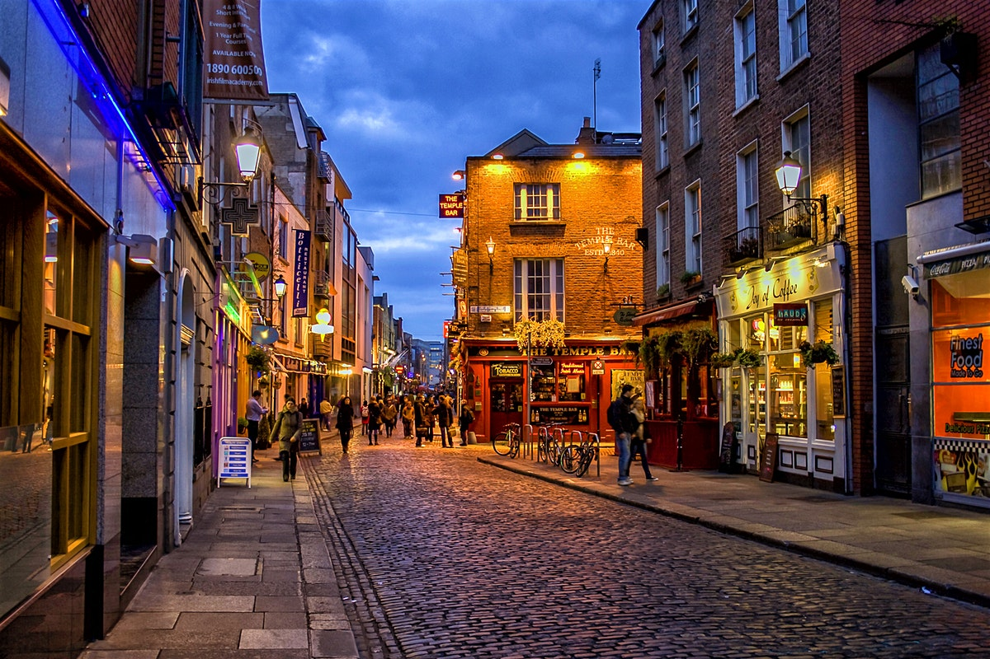
Itinerary
Day 4: Killarney-Dublin
  Travel to Dublin via Blarney Castle
  Blarney Castle Visit

Slide 4
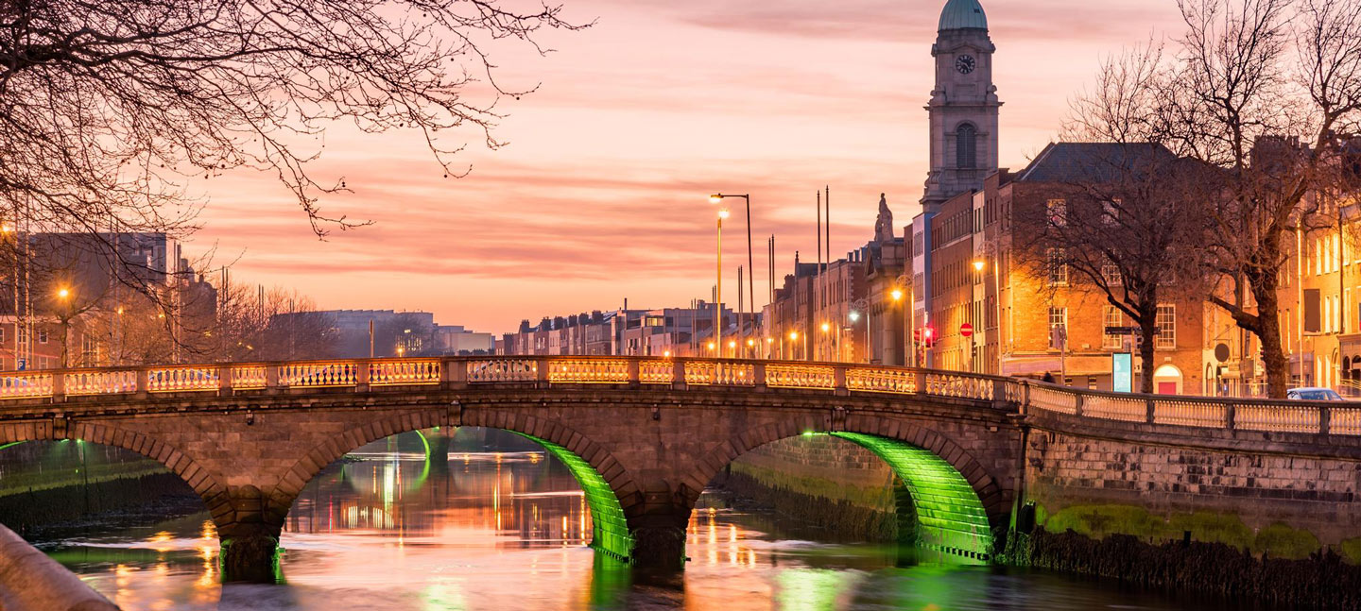
Itinerary
Day 5: Dublin Landmarks
Dublin guided sightseeing tour
Phoenix Park, St. Patrick’s Cathedral, Trinity College, Book of Kells visit, Dublin City Walk
O’Connell Street, Parnell Square, Henry, Street
Traditional Public House Dinner

Slide 5
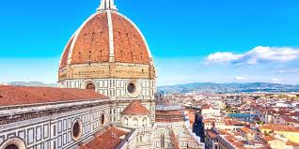
Itinerary
Day 6: Dublin - Florence
  Fly to Florence
Day 7: Florence Landmarks
  Florence guided walking sightseeing tour with Whisper headsets
  Palazzo Vecchio, Piazza della Signoria, Chiesa di Santa Croce, Ponte Vecchio, Duomo visit, leather workshop, Gates of Paradise, Giotto’s Bell Tower, Dante's House
  Pisa guided excursion
  Baptistery visit, Leaning Tower

Slide 6
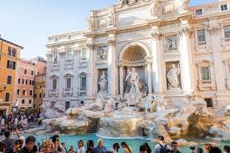
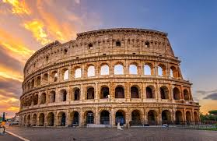
Itinerary
Day 8: Florence-Rome
  Travel to Rome
  St. Francis of Assisi Basilica visit
  Rome city walk
  Spanish Steps, Trevi Fountain, Pantheon, Piazza Navona
Day 9: Rome Landmarks
  Travel to the port
  Pompeii guided visit
  Overnight ferry to Patras

Slide 7
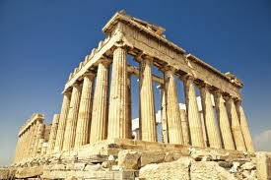
Itinerary
Day 10: Rome - Athens
  Fly to Athens
  Athens city walk
  Plaka district, Temple of Olympian Zeus, Hadrian’s Arch
  Dinner in Athens

Slide 8
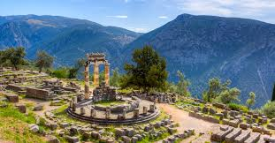
Itinerary
Day 11: Delphi
  Delphi guided excursion
  Delphi site visit, Temple of Apollo
  Greek dinner in Plaka

Slide 9
Itinerary
Day 12-14: Aegean Cruise
  Your cruise includes 2 shore excursions of your choice
    Day 1: First is Mykonos, one of the Mediterranean's busiest resorts, with everything from a great museum filled with 7th-century artifacts to pure white, cubistic buildings, Crayola-colored boats, gourmet restaurants and...more beaches
    Day 2: Next stop is Samos, best known for its beautiful beaches and lush greenery. Then it is on to the hilly, seahorse-shaped Patmos, you'll see gold-leafed Byzantine frescos at the Monastery of St. John, the capital city of Hora, the busy port of Skala and beautiful beaches. Cruise on to Heraklion, the capital of Crete and a former Minoan seaport, for an unparalleled collection of Minoan archaeological artifacts.

Slide 10
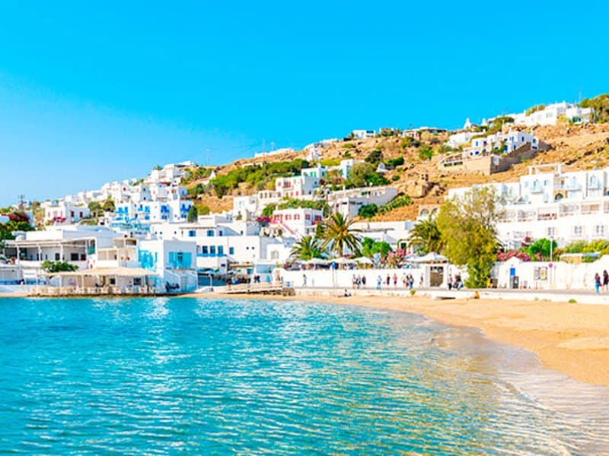
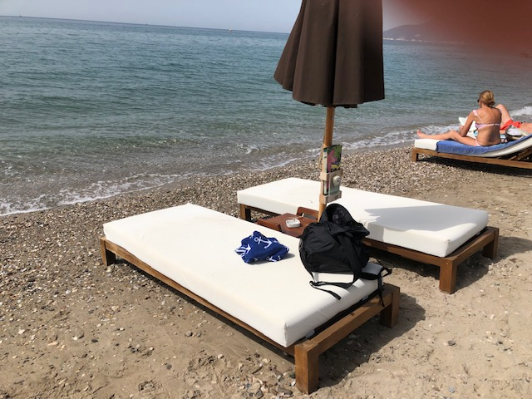
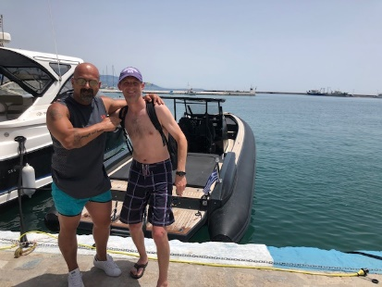
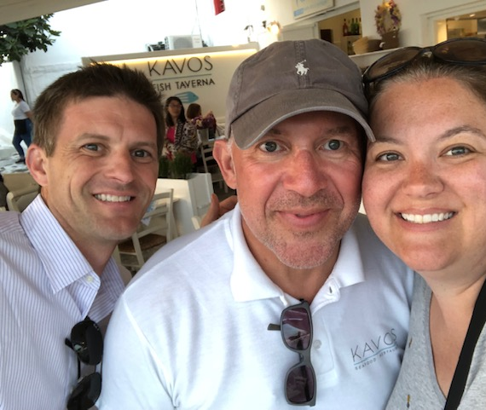
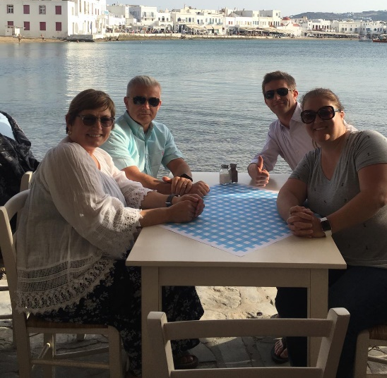
Mykonos & Samos

Slide 11
Itinerary
Day 12-14: Aegean Cruise
Day 3
  Finally, you’ll visit Santorini, where whole villages seem to cling to the side of the volcano, and mysterious black sand beaches stretch into the sea. Itinerary is subject to change.

Slide 12
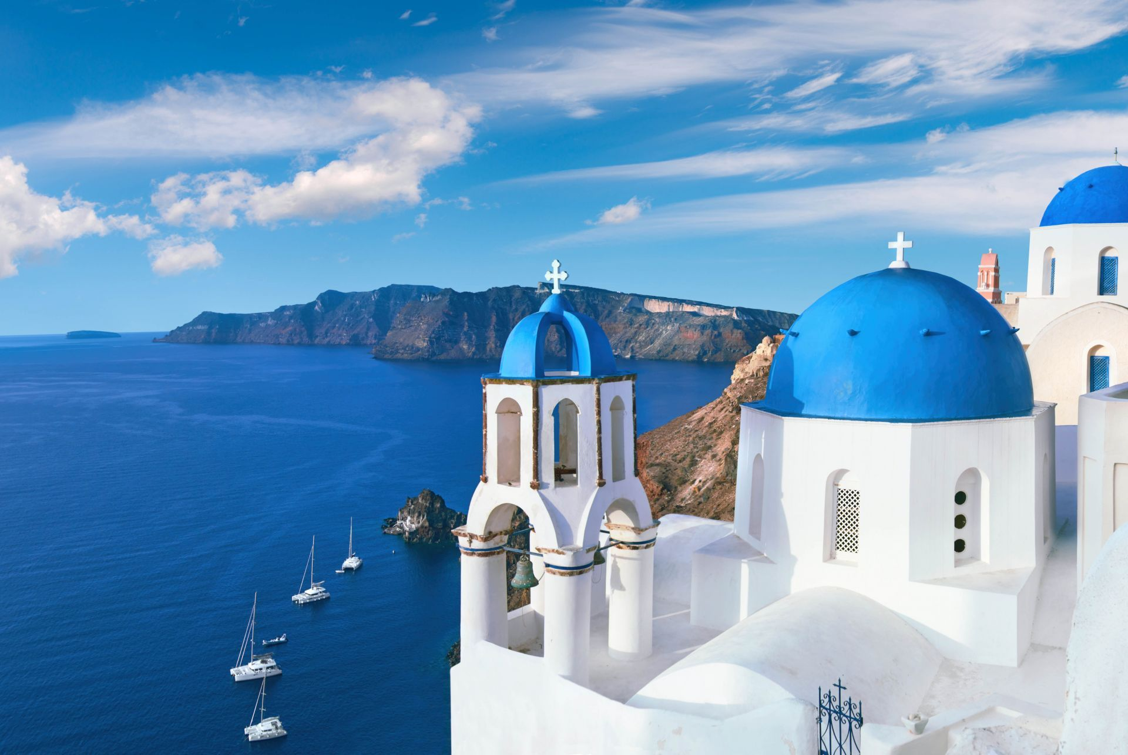
Santorini

Slide 13
Itinerary
Day 15 Athens Landmarks
  Athens guided sightseeing tour
  Parthenon, Acropolis visit, Temple of Athena Nike, Omonoia Square, Syntagma Square, 2004 Olympic site
  Dinner in Athens

Slide 14
Itinerary
Day 16- End Tour
  Fly back to United States

Slide 15
Included in Pricing
Round-trip airfare
3 overnight stays in cabins on ferry
11 overnight stays in hotels with private bathrooms
Full European breakfast daily
Aegean Cruise
Dinner daily
Full-time services of a professional tour director
Guided sightseeing tours and city walks as per itinerary
Visits to select attractions as per itinerary
Tour Diary™
Note: On arrival day only dinner is provided; on departure day, only breakfast is provided
Note: Tour cost does not include airline-imposed baggage fees, or fees for any required passport or visa. Please visit our Fees FAQ page for a full list of items that may not be included in the cost of your tour.

Slide 16
Current Student Pricing
Current pricing is based on 25 paying travelers
Without 25 paying travelers, the price is subject to increase
With more than 25 paying travelers, the price is subject to decrease

Slide 17
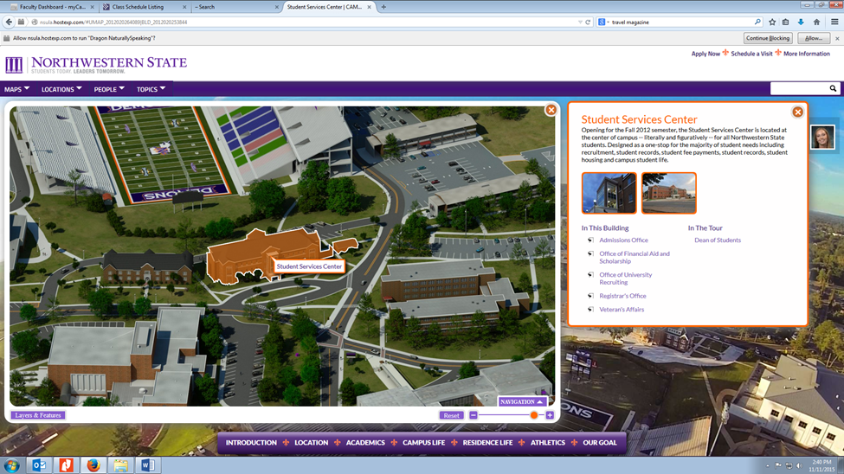
Instructions for Deposits
Deposits will be made as follows:
FIRST $850 to NSU Cashier’s Office on the Natchitoches Campus
Next- you will get instructions to enroll on Explorica website.

Slide 18
Instructions for Deposits
2. Tell the cashier that you need to deposit funds for the International Study Tour and give them the following information:
International Study Tour -
Banner Fund 274002
Org 227115
Program 10
Account Code 510649

Slide 19
Instructions for Deposits
3. Bring your receipt to Mrs. Jones!! If you do not bring your receipt to Mrs. Jones, we have no way of knowing who has paid and who has not!
You can give the receipt to our Administrative Assistant, Mrs. Ann Spillman, Room 132 FACS Building if Mrs. Jones is out of her office.
Once you bring the first $850 deposit to Mrs. Jones, she will give you the tour information website.

Slide 20
Requirements
Students traveling are required to enroll in HMT 3120: International Travel Preparation
Taught Fall 2019 B-Term and again in Spring 2020
Students must enroll in HMT 3150 Summer 2020

Slide 21
Important Notes
Financial Aid is available for Travel & Tourism students, student’s responsibility- some resources available
Students must adhere to NSU Student Handbook, disciplinary procedures will be followed if necessary
Travel Insurance- increased medical and emergency is required

Slide 22
For More Information
Contact salterv@nsula.edu or 318-357-4610

