Slide 1
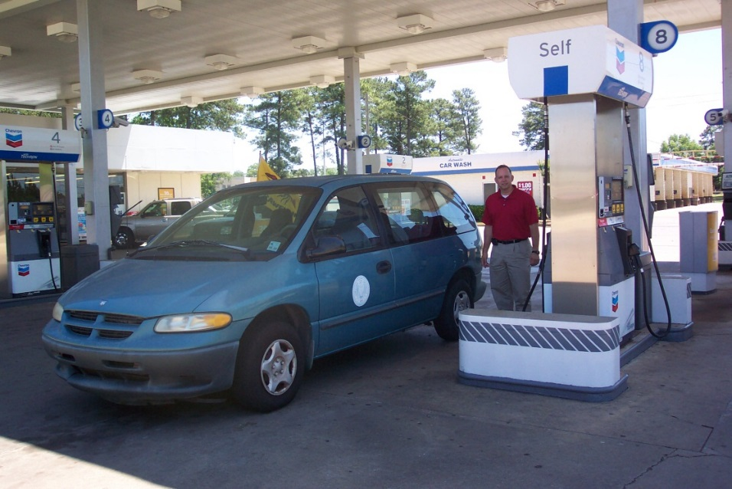
FuelTrac Credit Card Program
Administered by Northwestern State Office of Motor Pool
The FuelTrac credit card may ONLY be used for State owned Vehicles or those leased through the State Enterprise Contract.
Northwestern State Office of Motor Pool: 318-357-5701
brossette@nsula.edu or vascocul@nsula.edu

Slide 2
Obtaining a PIN
Fuel cards are issued to vehicles and gas receptacles.
A PIN is issued to an employee authorized to drive on University business.
To obtain a PIN:
  Become or be an authorized driver (guidance provided in this presentation);
  Complete the FuelTrac Card User Agreement (at the end of this presentation); and
  Email a valid drivers license and completed form to the Office of Motor Pool (auxiliaryservices@nsula.edu).

Slide 3
Motor Pool Vehicles
Drivers are assigned a PIN;
Use PIN accompanying card and attached to keys;
Must be authorized to drive for University business(guidance provided in this presentation);
Complete a Trip Ticket (received with keys) and MV-3 form (if in vehicle-guidance provided in this presentation);
Must adhere to FuelTrac Card User Agreement guidelines on reverse side of Trip Ticket; and
Attach fuel purchase receipts to Trip Ticket upon return and delivery to University Police Dispatch.

Slide 4
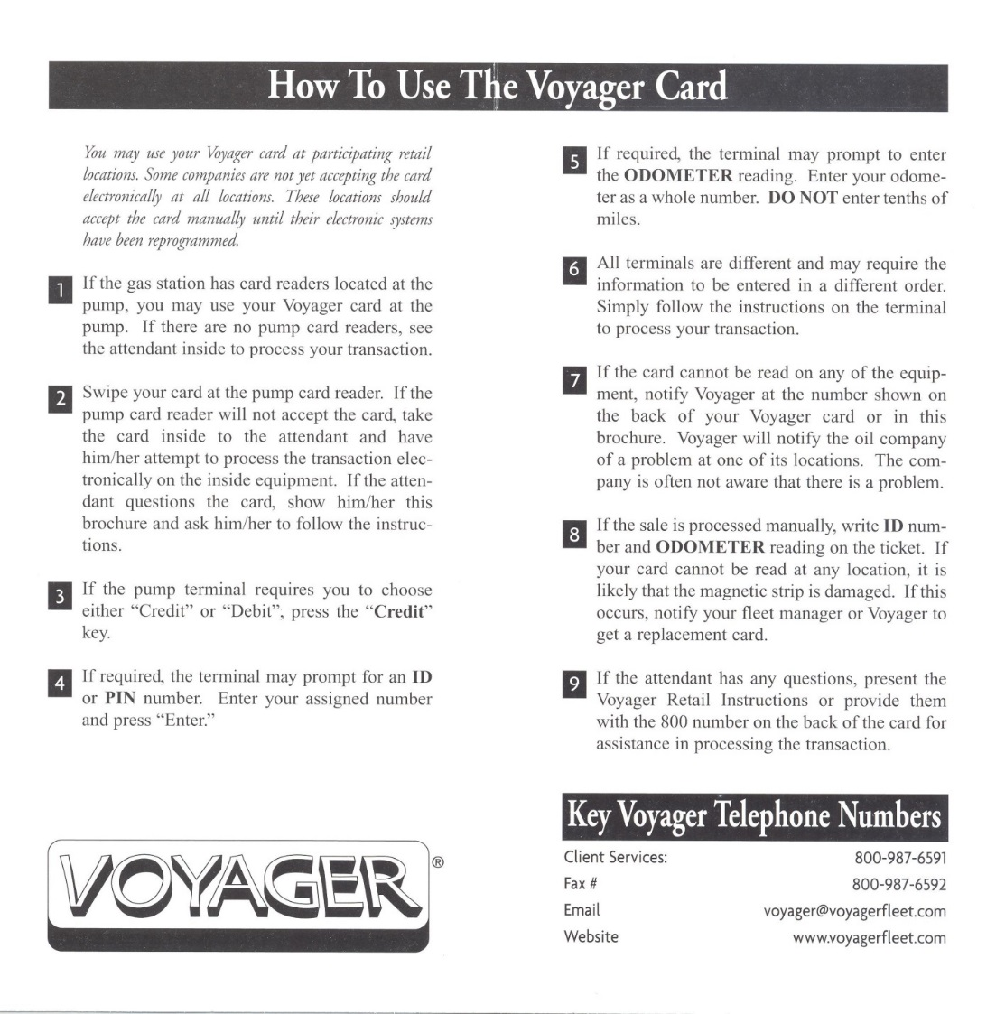

Brochure for card use is located in the glove compartment for all Motor Pool vehicles.

Slide 5
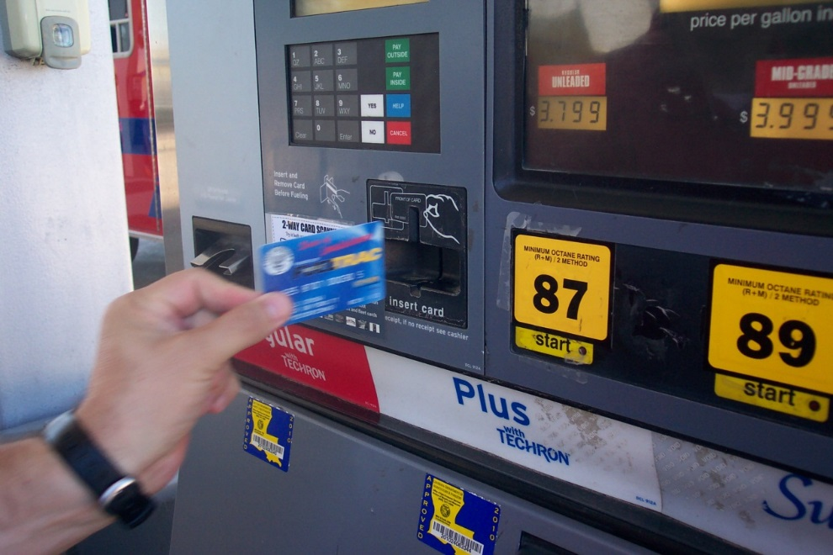
Fueling the Vehicle
Always pay at the pump, unless store requires inside purchase.
Swipe card;
Choose regular unleaded only;
When prompted:
  Enter PIN
  Enter actual odometer reading at the time of fuel purchase;
Fuel Vehicle; and
Obtain receipt to be attached to Trip Ticket or MV-3 for on campus vehicles.
After 3 unsuccessful attempts to enter PIN, the card will be locked and you will need to call Motor Pool.

Slide 6
Filling Gas Containers/Tanks
FuelTrac cards are issued to specific departments and assigned to receptacles for the purpose of fueling University equipment.
Authorized users are required to use their PIN for these purchases.
Do not record any numbers as an odometer reading.
A Diesel card may only be used to purchase diesel.
A can/tank card may be used to purchase regular unleaded and Supreme.
Supreme may only be purchased for small equipment that requires high octane fuel.
Cards assigned to Gas Containers/Tanks may not be used to fuel vehicles.
Off-road vehicles (golf carts, mules, ATVs, mowers, etc.) may not be driven off campus to be fueled.
Purchases for Gas Containers/Tanks are not recorded on MV-3 forms.

Slide 7
Becoming an Authorized Driver
Review the Driver Safety policy at http://ehs.nsula.edu/driver-s-safety/.
Complete Driver Safety training online per policy instructions.
Complete a DA-2054 (Driver Authorization Form) per policy instructions and submit to the Safety Coordinator via campus mail or hand deliver to the Physical Plant.
Motor Pool will be notified when driver becomes authorized to drive for University business.

Slide 8
Completing the MV-3
MV-3 is the Daily Vehicle Log.
For each day a vehicle is in use, enter the date, ending odometer reading and mileage calculation.
Record initials of driver in the applicable box.
Enter location or activity for mileage used; if on campus only, record “campus use.”
Record purchases of fuel on date of purchase to include gallons and fuel cost.
Attached fuel purchase receipts to MV-3.
At end of month, calculate total mileage, gallons of fuel purchased and total fuel cost.
Compare MV-3 with itemized fuel purchase transaction report received from Motor Pool.
Provide Supervisor with completed MV-3 and itemized report for review.
Supervisor must sign as an indication that all information is correct.
Errors are to be investigated and noted on reports or on memo attached to report and provided to Motor Pool.
Provide Motor Pool with completed reports by the 3rd working day of the following month.

Slide 9
Additional MV-3 Information
Maintenance or repairs are to be recorded on back of the Daily Vehicle Log, with the cost carried to the front in the respective box and date.
MV-3 are assigned to specific vehicles and should not be used for multiple vehicles.
A trip may include more than one location, but will not include more than one day.
Whenever the driver changes, it is the end of one trip and the beginning of another.
Information on the MV-3 must be legible. If an error is made, make a single strike through the error and write the correct information in the next available space.
Record the correct mileage at the end of a trip and do not record trips out of chronological order.

Slide 10
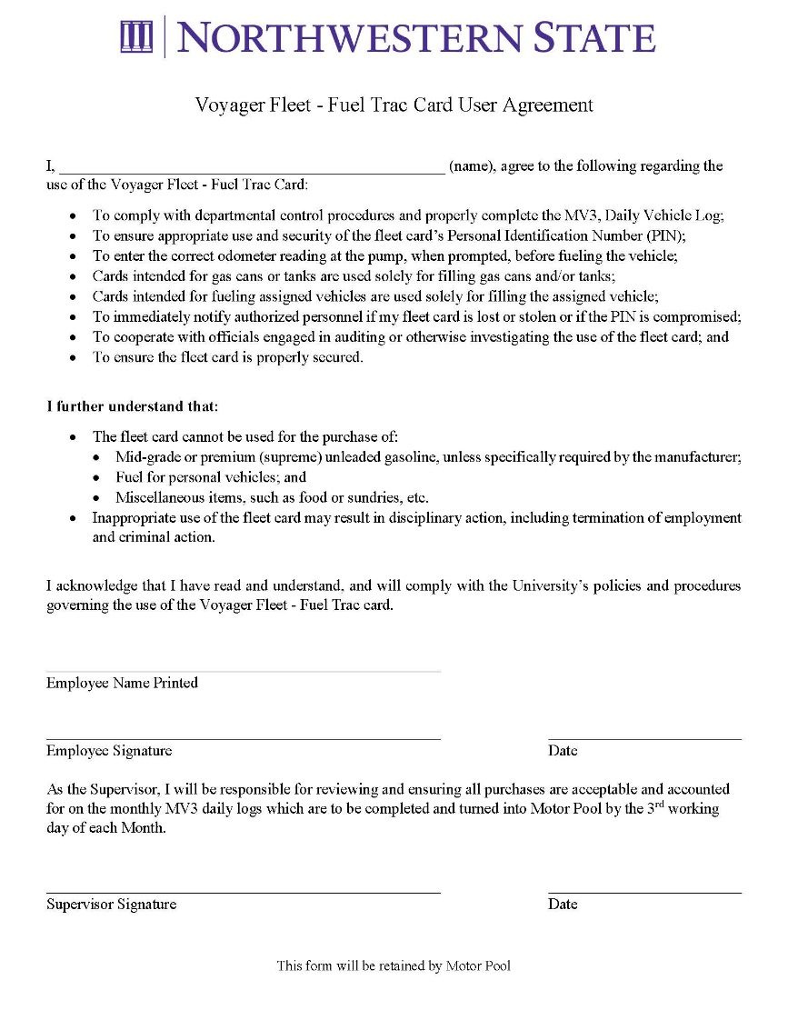
FuelTrac Card User Agreement
Prior to receiving a PIN for the FuelTrac Card, this form is to be printed, completed, signed by Supervisor and delivered to Motor Pool.
Inability to adhere to guidelines will result in PIN deactivation.
Under NO circumstances is any grade of fuel other than regular unleaded to be used to fuel any vehicle unless indicated by the manufacturer of the vehicle.
Click here to download and print form

