Slide 1

Implicit Bias
Controlling our unconscious
Presented by:
Cut on the Bias
NSULeAds
Notes:
J Mac

Slide 2
Introduction
Notes:
JMac

Slide 3
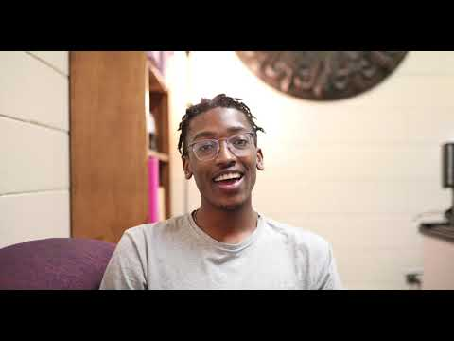
Student Perspectives

Slide 4
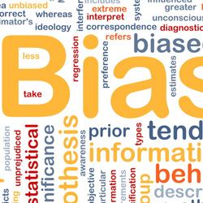
What is Implicit Bias?
Attitudes or stereotypes that affect our understanding, actions, and desires in an unconscious manner. Implicit bias...
...is activated involuntarily.
...cannot control for social/political correctness.
...is not accessible through introspection.
...predicts behavior in the real world.
Notes:
Katrina

Slide 5
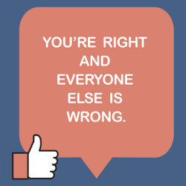
Key Characteristics
Biases are pervasive: everyone has them.
Implicit and explicit biases are related but distinct mental constructs.​
Biases do not necessarily align with our declared beliefs or reflect stances we would explicitly endorse.
We generally tend to hold biases that favor our own in-group.
Biases are malleable.
Notes:
Katrina

Slide 6
How to Test Implicit Bias:
Implicit Association Test (IAT) at https://implicit.harvard.edu/implicit/takeatest.html
Case Study
  White male Professor at NSU who took gender, race, and disability preference tests
Results:
  Strong automatic preference for European Americans over African Americans
  Moderate automatic preference for Male with Career and Female with Family
  Moderate automatic preference for abled over disabled
More details:
  covers Bias, Institutional Racism, and Disability Studies as part of curriculum
  Wrote dissertation on Disability Studies
  Membership in National Disability Societies and Advocacy Groups
  Christian in a church that prides itself on acceptance of LGBTQ+ members with leadership that is racially diverse and female-inclusive
Last Test:
  Strong automatic preference for Bill Clinton over Donald Trump
Notes:
John

Slide 7
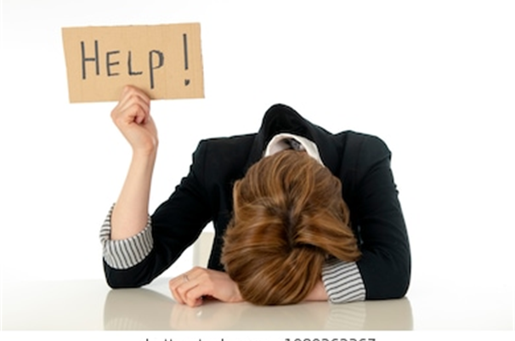
Can you get rid of negative biases?
Mindfulness techniques
  state of being—often practiced through meditation—that involves an increased awareness of our emotions, thoughts, and surroundings, accompanied by a sense of acceptance and non-judgment
  1. Context for people’s actions (correspondence bias)
  2. Decrease wariness in social encounters (negativity bias)
  3. See others as equals (self-positivity bias)
Notes:
John

Slide 8
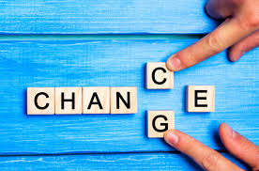
How do we make that change?
Overall, it may be a challenge
There are approaches:
I.M.P.L.I.C.I.T.

Slide 9
I – Introspection
Explore yourself and identify your own types of prejudices
Can be done through the self-tests (previously mentioned) or other forms of self-analysis
M – Mindfulness
Pressure, stress, distraction, negative emotion, etc., are more likely to lead towards biases
Be aware of and practice ways to reduce stress and increase mindfulness
Notes:
Jim

Slide 10
P – Perspective-taking
Consider the experiences and viewpoint of the other person
"Don't be too quick to judge" is an old saying that still works
L – Learn to slow down
Before interaction, pause and reflect to reduce reflexive actions; for example, if feeling anger or disgust, wait to calm down first
Notes:
Jim

Slide 11
I – Individuation
Evaluate a person based on their own personal characteristics
Focus on these personal attributes of an individual rather than the stereotypes tagged with social groups
C – Check your messaging
Use conversation that is welcoming and embracing of multiculturism and differences
The "color-blind" or "we don't see color" approach has been shown in research to increase bias
Notes:
Cade

Slide 12
I – Institutionalize equity
Establish and support a culture of diversity and inclusion
Seek out these opportunities to interact and work with individuals from stigmatized groups, in both professional and personal contexts
T – Take two
Resisting these biases is a lifelong process
"Take two" and at times restart these processes to look for new ways to improve
Notes:
Cade

Slide 13
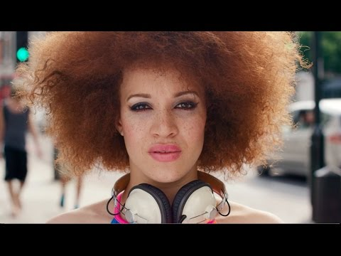

Slide 14
Conclusion
Everyone has implicit biases.
They are unconscious (beyond our own awareness) thus may surface in times of heightened emotion and stress.
They can contradict our spoken beliefs and values.
Mindfulness practices can give us glimpses of our own unconscious implicit biases allowing us to learn and improve ourselves and our society.

Slide 15
Conclusion
Implicit Bias is difficult to overcome, but not impossible.
Remember to be IMPLICIT in your approach:
-Introspection
-Mindfulness
-Perspective-taking
- Learn to slow down
-Individuation
-Check your Messaging
-Institutionalize equity
-Take two

Slide 16
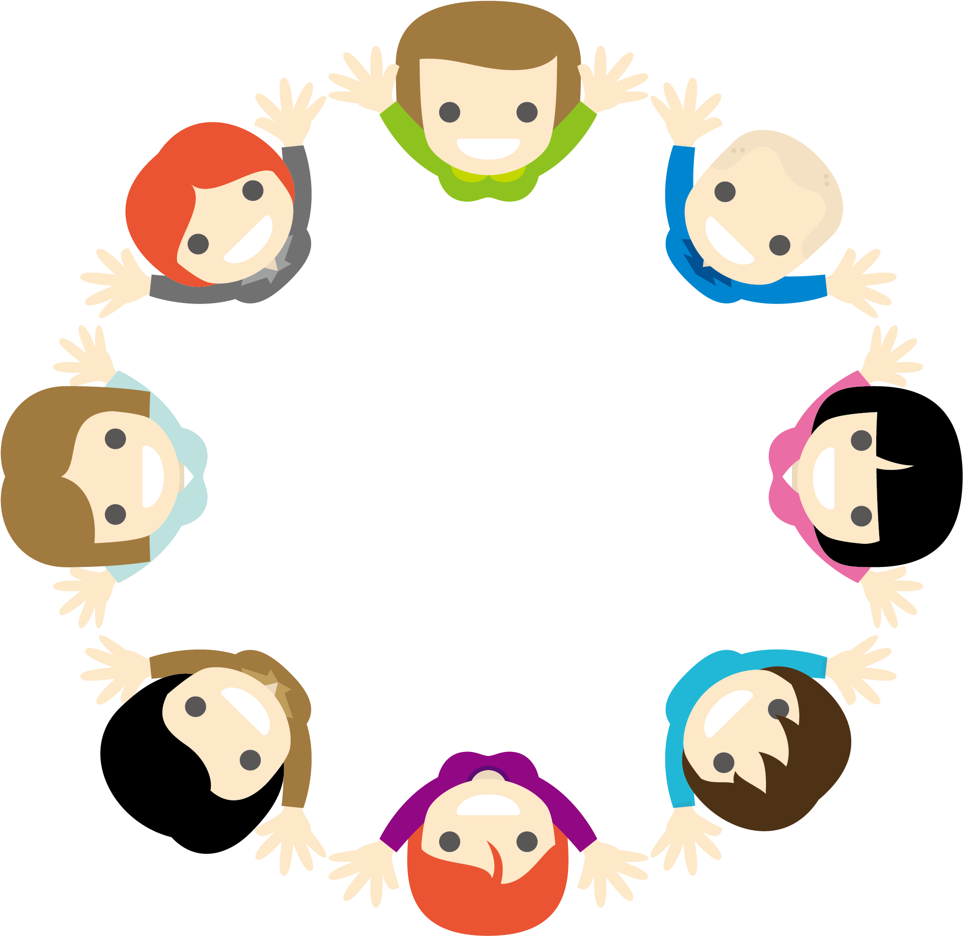
Take – Away Exercises
Examine your inner circle:
Create an excel sheet/grid.
2. In the first column, write 5 people you absolutely trust.
3. In subsequent columns write their gender, ethnicity, religion, political view, education level, etc.
4. If your inner-circle of trusted friends does not have diversity in certain areas, challenge yourself to expand your circle.
Take the bias tests for yourself:
Go to nsu.la/Bias to get started.

Slide 17
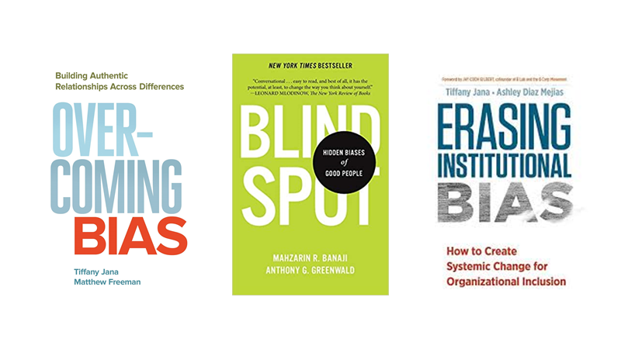
Additional Resources

Slide 18
Q and A
Notes:
Holly

Slide 19
Sources
Mason, Betsy. “Curbing Implicit Bias: What Works and What Doesn’t” https://www.discovermagazine.com/mind/curbing-implicit-bias-what-works-and-what-doesnt
Accessed November 10, 2020.
•Suttie, Jill. “Three Ways Mindfulness can make you less biased.” https://greatergood.berkeley.edu/article/item/three_ways_mindfulness_can_make_you_less_biased. Accessed December 8, 2020.
Turner, Rhiannon N. “Imagining intergroup contact reduces implicit prejudice” The British Journal of Social Psychology Vol. 49, #1 (March 2010), 129-142. https://doi.org/10.1348/014466609X419901
“Understanding Implicit Bias” http://kirwaninstitute.osu.edu/research/understanding-implicit-bias/Accessed 10/26/2020.

