Slide 1
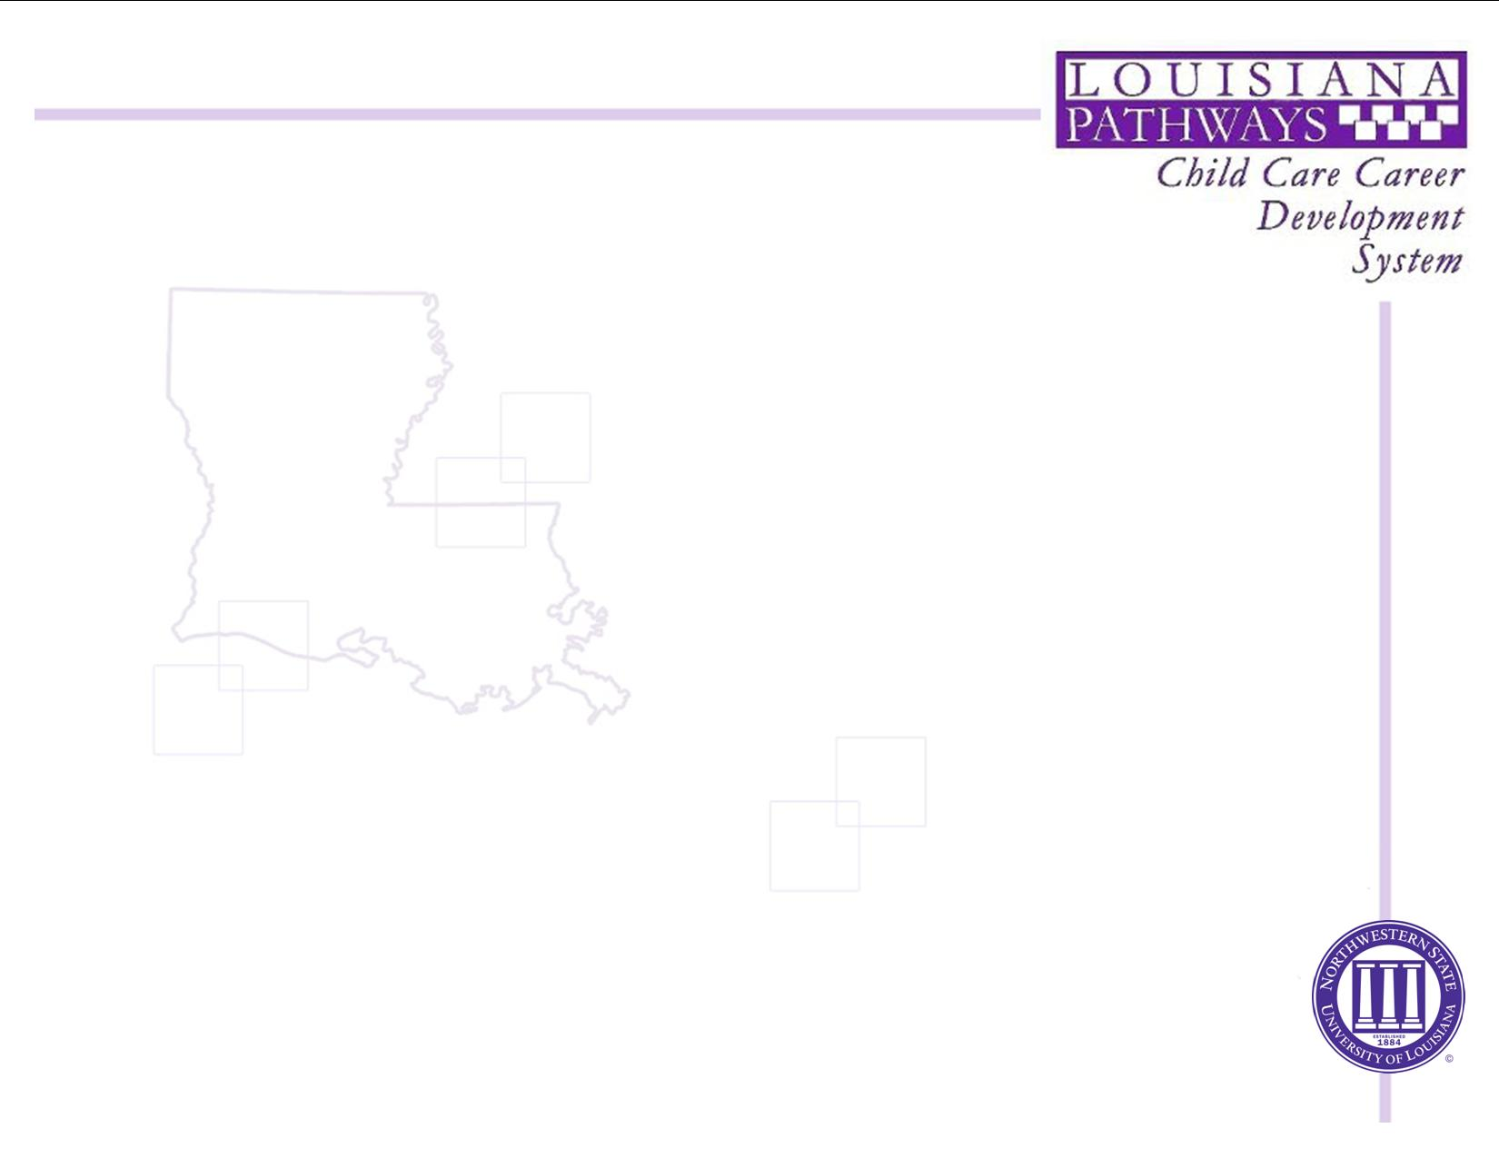


Louisiana Pathways Orientation
Presented by:
Jenny Cowan
Pathways Coordinator

Slide 2
Overview of workshop
This workshop will include….
  Orientation to LA Pathways Career Development System
    Career Development
    Scholarships
    Trainer Approval
Notes:
Paper airplanes here

Slide 3
What is Louisiana Pathways?
The Louisiana Pathways Early Learning Center Career Development System is a major initiative funded by the Louisiana Department of Education to improve quality of child care in Louisiana. It is a statewide program designed to help early learning center employees receive recognition they deserve.
Participation is voluntary and there are no fees for enrolling; however, individuals MUST be enrolled to be eligible for the School Readiness Tax Credit for Directors and Staff.

Slide 4
Pathways Promotes:
Creating a quality workforce for early childhood programs by encouraging and supporting early childhood as a career
Increasing the quality of programs for young children by raising the level of education for all early learning center staff so children in Louisiana will have quality caregivers
Providing staff with the recognition they deserve
Reducing turnover in the field (a major issue in quality and costs to early learning centers)

Slide 5
Pathways….
  …is not a training agency. We do not provide workshops, CDA training or the NAC (National Administrator Credential) training.
  …does not award the CDA nor the NAC credential.

Slide 6
Career Development
    Career Ladders
    Tax Credit Eligibility
    Workforce Registry

Slide 7
Career Development
Maintains file folders and database which includes:
  Demographics
  Employment information
  Education
    Training certificates, diplomas, degrees, transcripts, credentials (CDA, NAC)
    Placement on career ladder
    Membership to professional organizations and service to the profession

Slide 8
Pathways Enrollment
Enrollment requires submission of Enrollment Form and Employment Verification.
Employment Verification form must be signed by someone other than the member who has access to employment records (preferably Director or Owner).
Members should send in copies of training records (workshop certificates, transcripts, credentials, etc.)

Slide 9
After Enrollment
All correspondence, certificates & requests for additional information are sent to member’s home address, not the center.
  While directors may submit necessary information, it is ultimately the member’s responsibility to make sure their information is submitted for leveling.

Slide 10
Career Development
Career Ladders
  Members are placed on career ladders based on information submitted:
    Classroom Track
    Administrator Track (Directors/Assistant Directors)
    Family Child Care

Slide 11
Pathways &
School Readiness Tax Credits
Pathways supports SRTC by:
  Enrolling all interested individuals in Pathways
  Maintaining employment & training records based on information received
  Advising members of what they need to advance
  Working with centers to maintain accurate staffing information –Director's Reports

Slide 12
School Readiness Tax Credits
For Businesses
For Parents
For Child Care Providers
For Directors and Staff Members

Slide 13
Career Development
School Readiness Tax Credits for Directors & Staff
  Place members on the career ladder based on the documentation received. Members who are at Early Learning Teacher 1, 2, 3, 4, Master Teacher, Director 1, 2, 3, and 4 are on tax credit eligible levels.
  Mail SRTC forms to all active members who have achieved a tax credit eligible level on January 31st of the following year.
  Advise LDOE & the Louisiana Department of Revenue of all members who are on a tax credit eligible levels.

Slide 14
Career Development
New Career Ladder for teachers went into effect beginning with 2019.

Slide 15
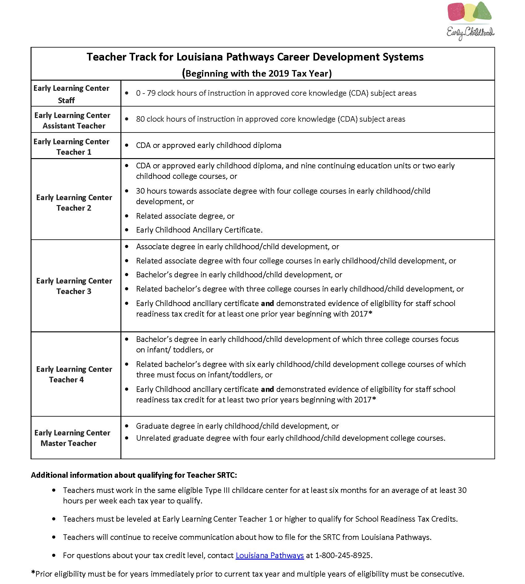

Slide 16
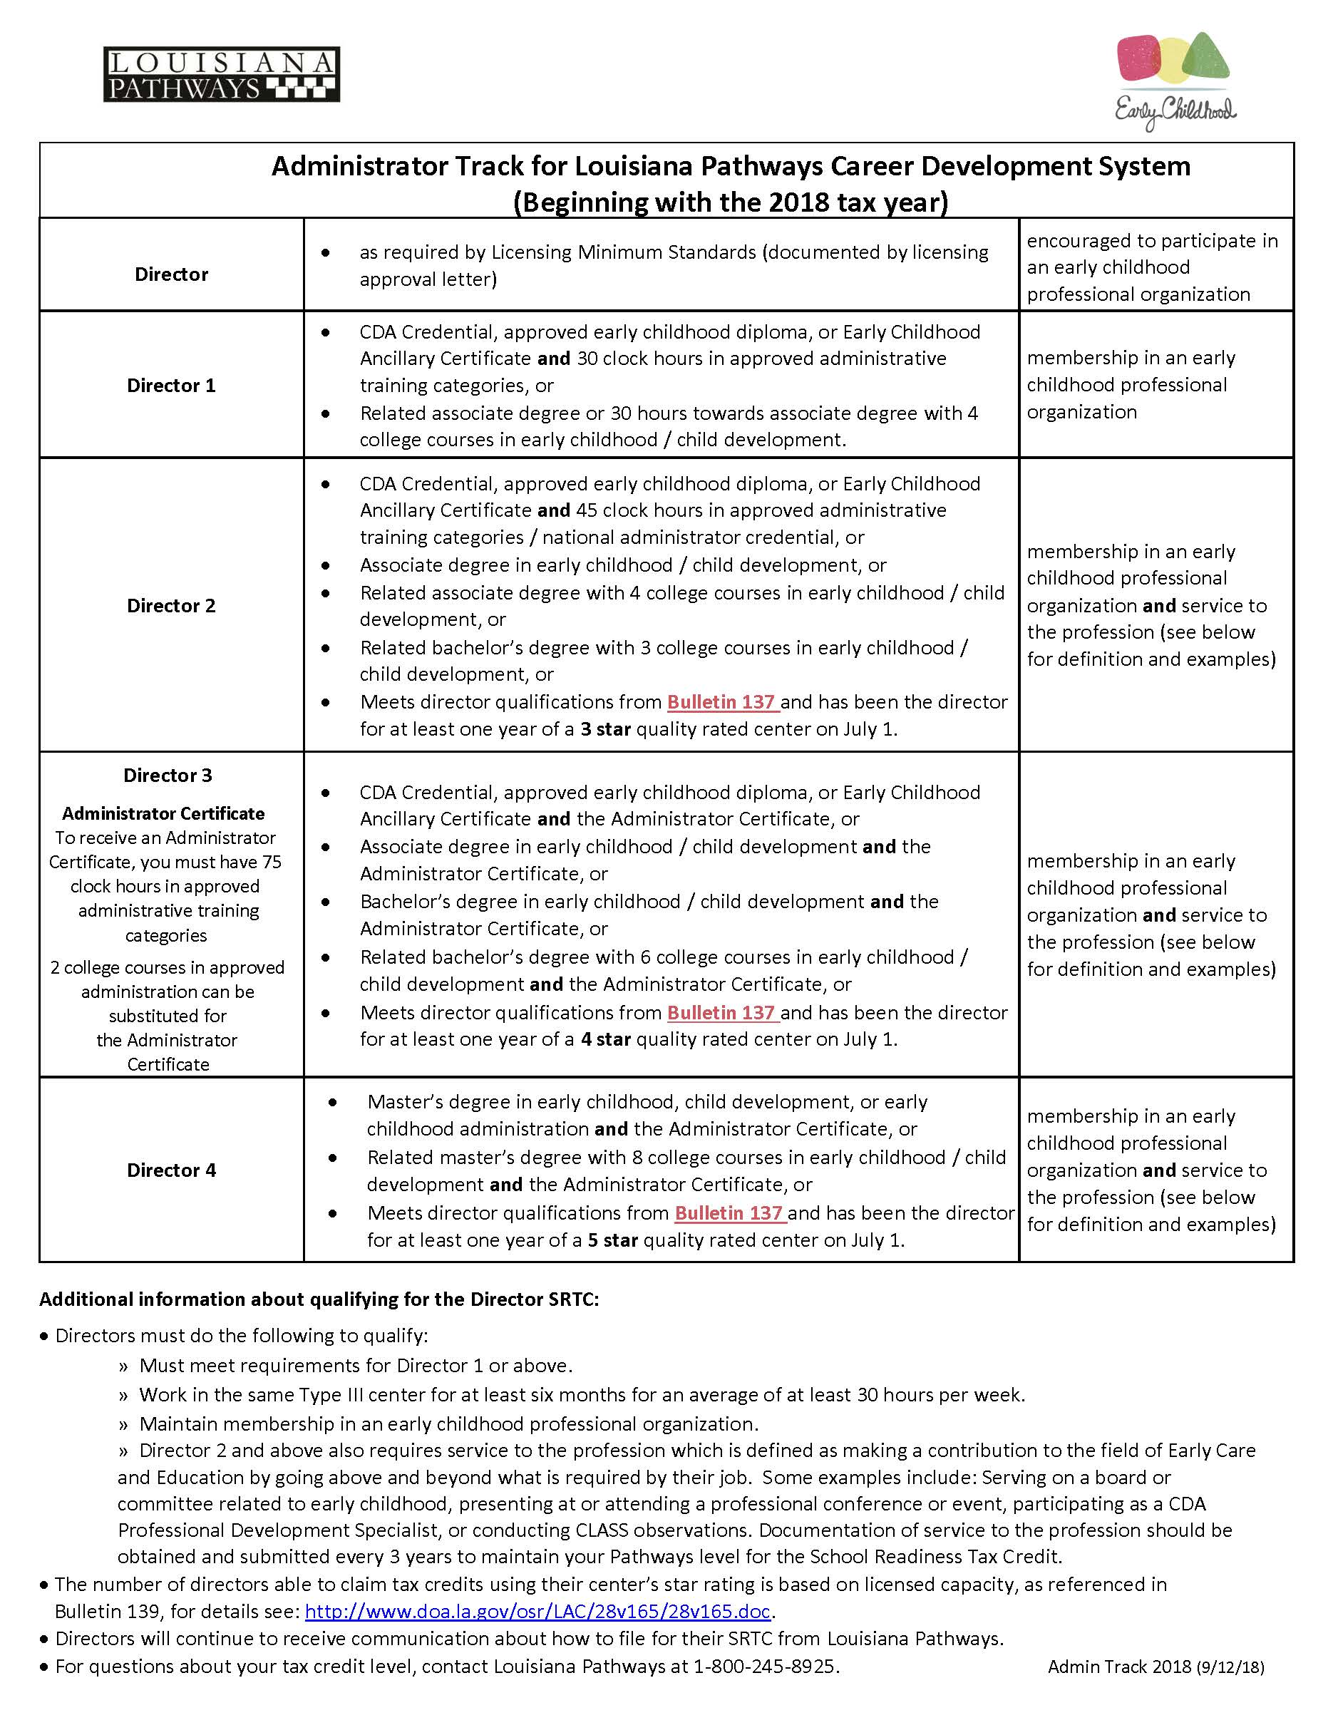

Slide 17
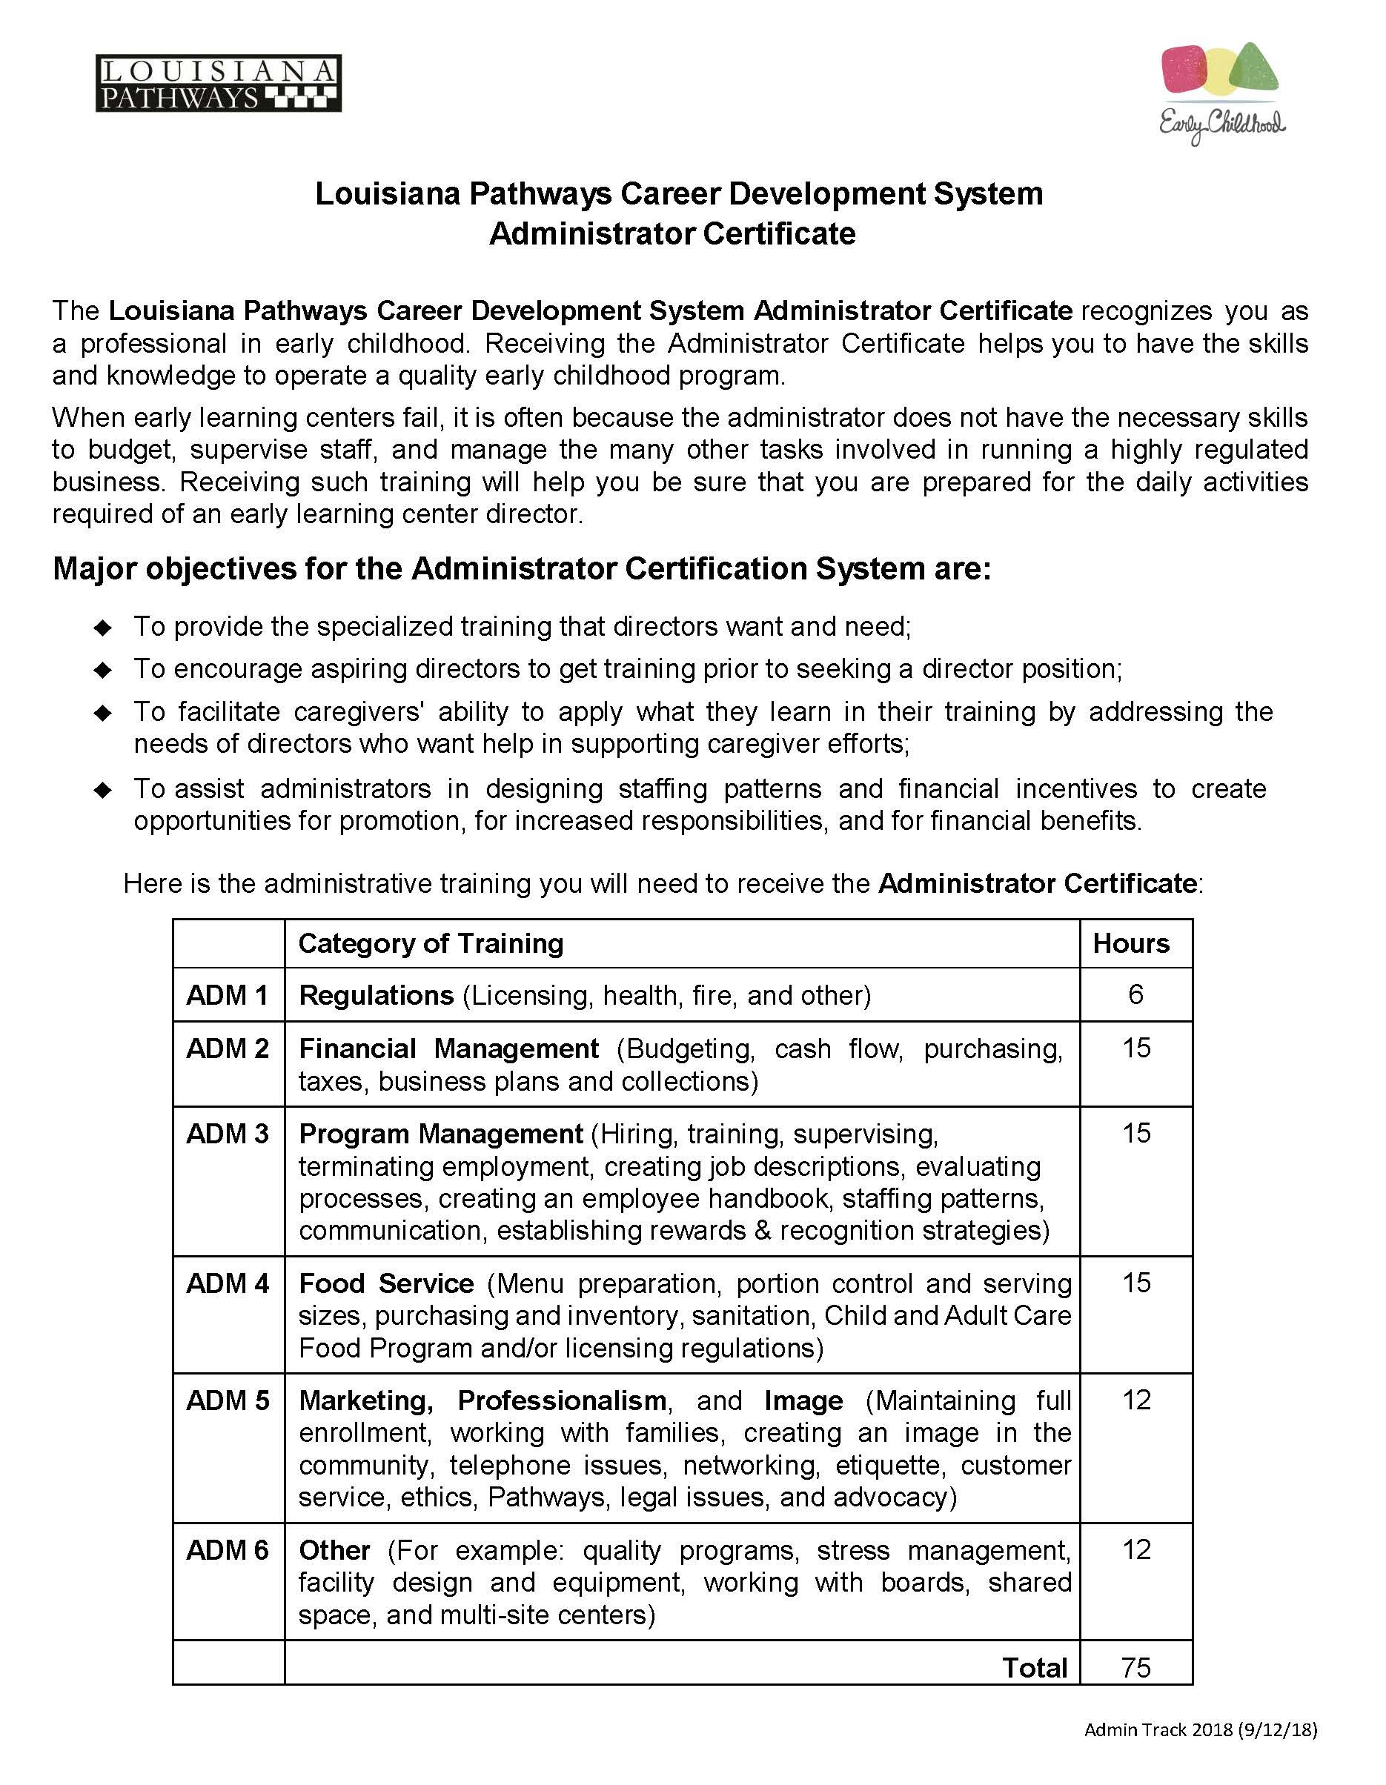

Slide 18
Notes about SRTC:
  While directors may submit necessary information, it is ultimately the member’s responsibility to make sure their information is submitted for the tax credit.

Slide 19
Notes about SRTC:
  Members should contact Pathways to update contact information and ensure that their level is current and valid for the entire year.

Slide 20
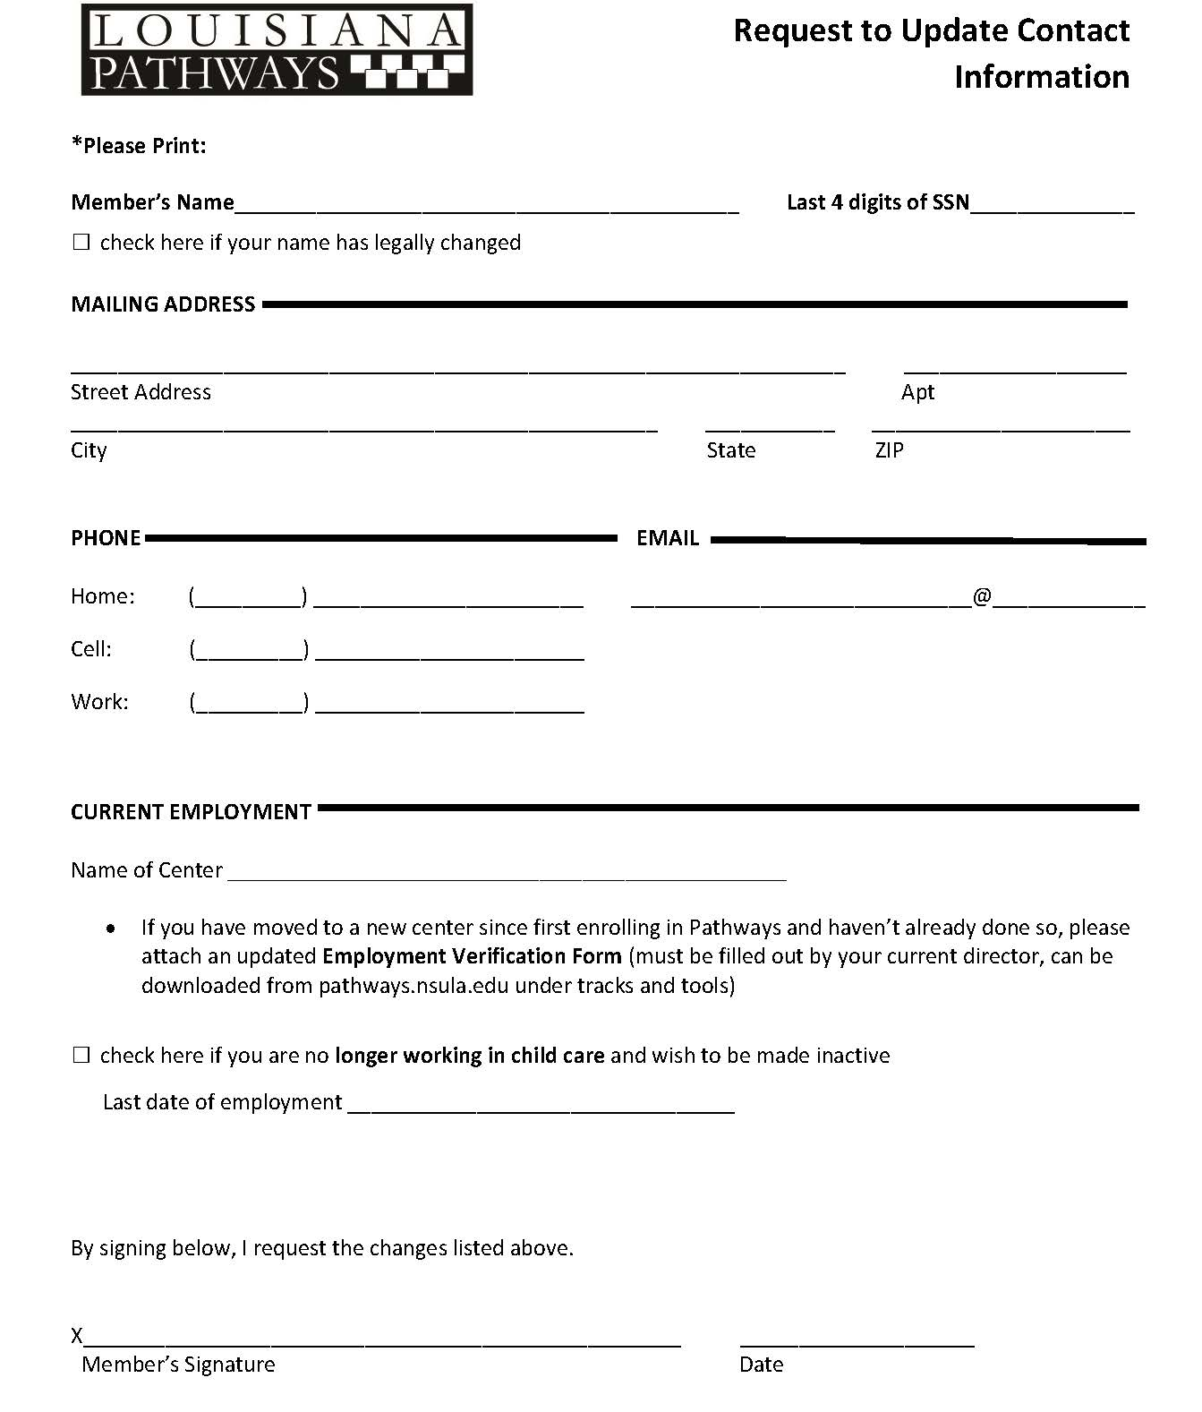

Slide 21
Notes about SRTC:
  Career Ladder levels must be achieved or maintained by the end of each tax year (December 31st).

Slide 22
Notes about SRTC:
  In order to maintain levels, CDA’s, ECAC's and professional organization memberships must be current.
    Expired credentials (CDA and ECAC) cannot be used to meet leveling requirements.
    If credentials are due to expire before the end of the tax year, you must submit renewal documentation.
    Failure to do so could result in member moving to a lower level.
    You do not have to renew your CDA to renew your ECAC.

Slide 23
Notes about SRTC:
  In order to receive your tax form the 1st week of February, deadline for submitting information is December 31st of the previous year. Mail will be processed for the year that it is postmarked by this date.
  Information received after December 31st, will still be processed for evaluation of tax credit eligibility, but the tax form probably won’t be sent on January 31st.

Slide 24
Notes about SRTC:
  In addition to being on an eligible level, individuals must have worked for an average of 30 hours a week for at least 6 months of the calendar year at the same participating Type III center to claim the tax credit.
  It is up to each member and their employer to determine if all other tax credit requirements have been met in order to claim the School Readiness Tax Credit for Directors and Staff.

Slide 25
Notes about SRTC:
  Because Pathways does not determine who can use the tax forms Pathways provides, beginning in 2017, Pathways has mailed 2 identical tax forms to members who may be eligible to claim the SRTC and asked that 1 be returned to Pathways once completed
    Returning a complete tax form back to Pathways is the only way to "demonstrate evidence of tax credit eligibility" for each tax year.
    This also helps Pathways determine who is still working in the field.

Slide 26
Notes about SRTC:
  Louisiana Pathways does not give out any money. Members use the form provided to file with their Louisiana State Income Taxes.
More information about the tax credits can be found at DOE's website: Louisiana Believes
FAQs for Staff and Directors PDF
2019 School Readiness Tax Credit Center Star Level

Slide 27
Notes about SRTC:
  The toll-free number for the Louisiana Department of Revenue is:
    1-855-307-3893
    Ask for: Taxpayer Compliance

Slide 28
Scholarships
College Tuition
Administrative Training
Ancillary Training
CDA Assessment
  Second Setting
NAFCC Accreditation

Slide 29
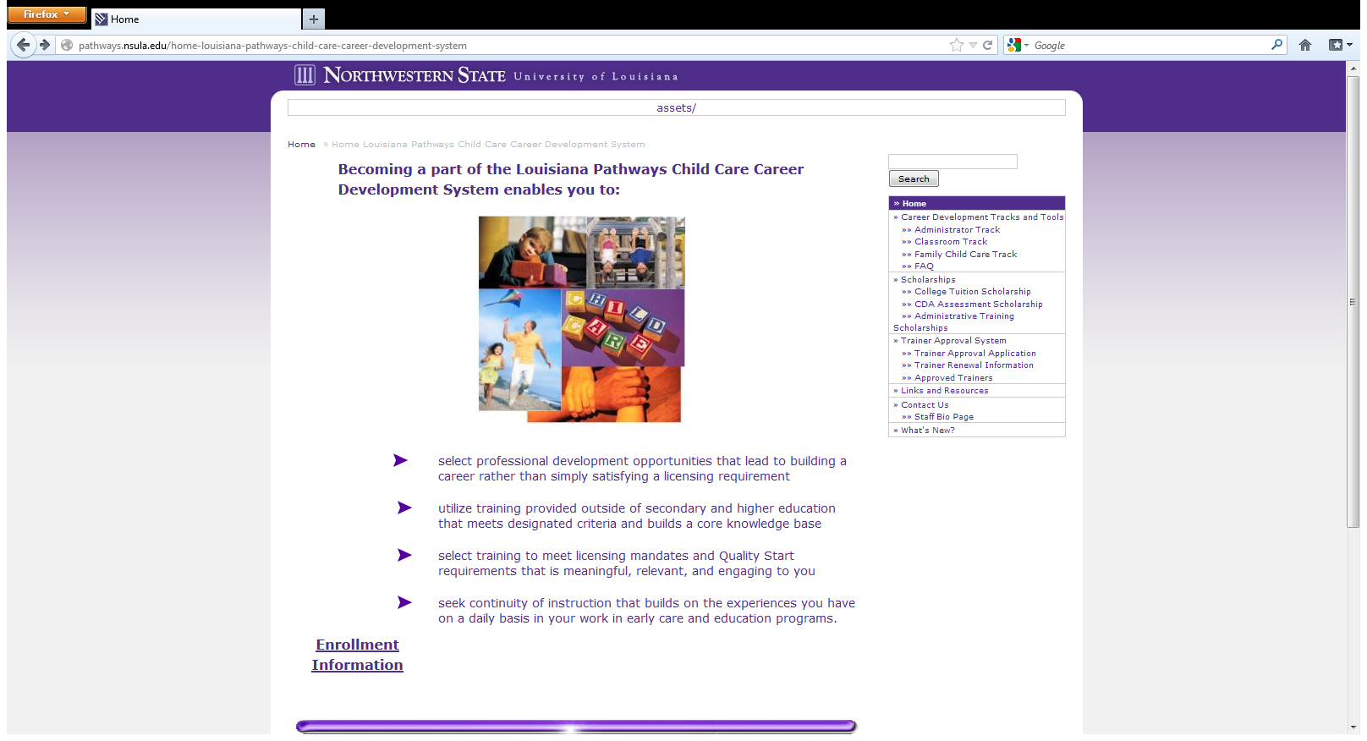
http://pathways.nsula.edu

Slide 30
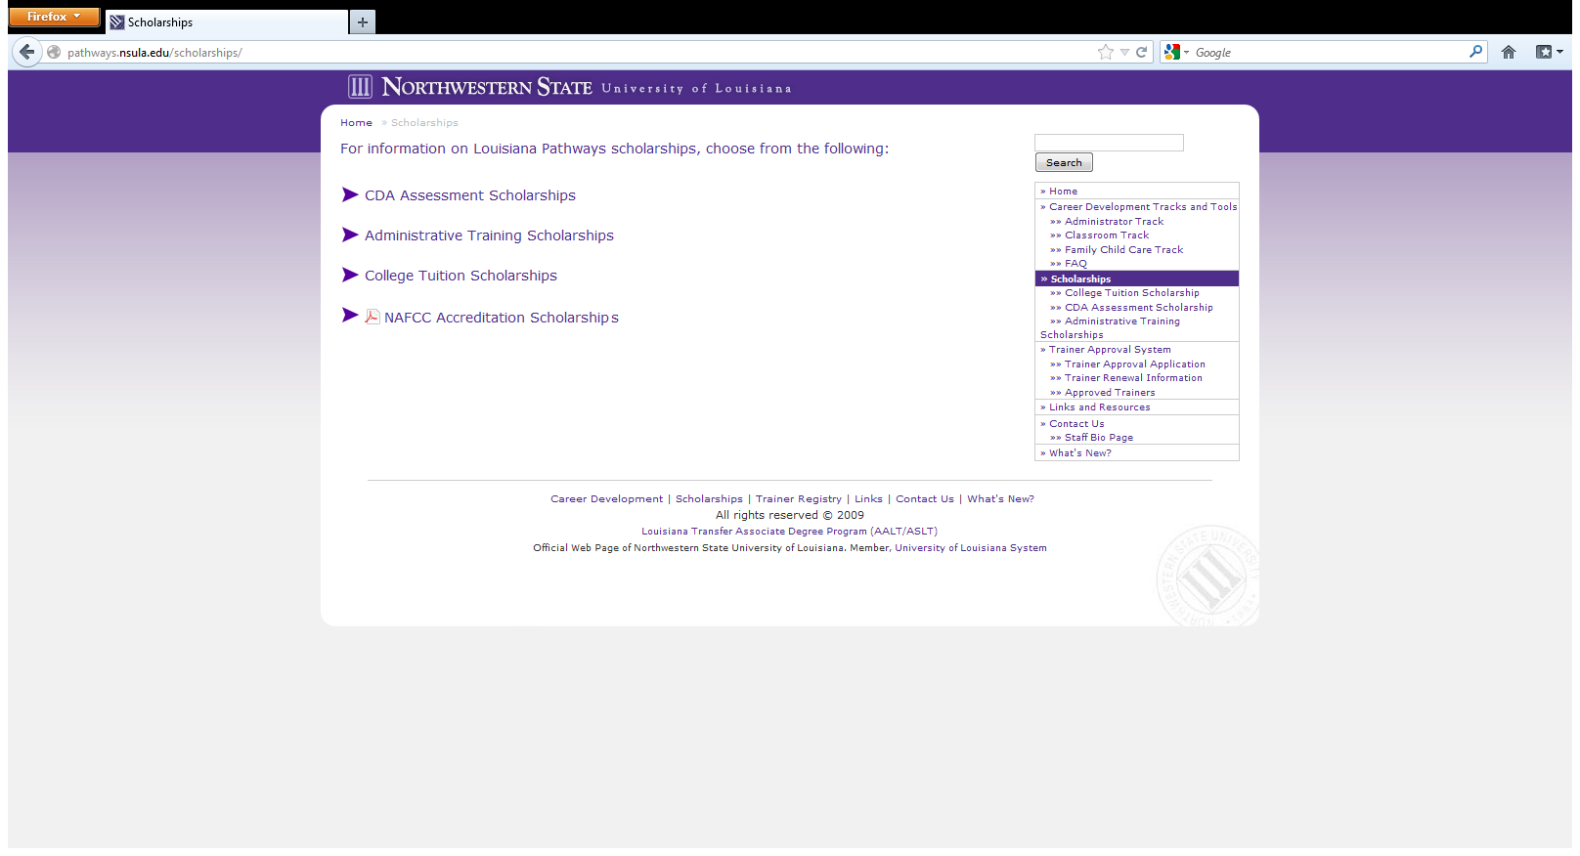
http://pathways.nsula.edu

Slide 31
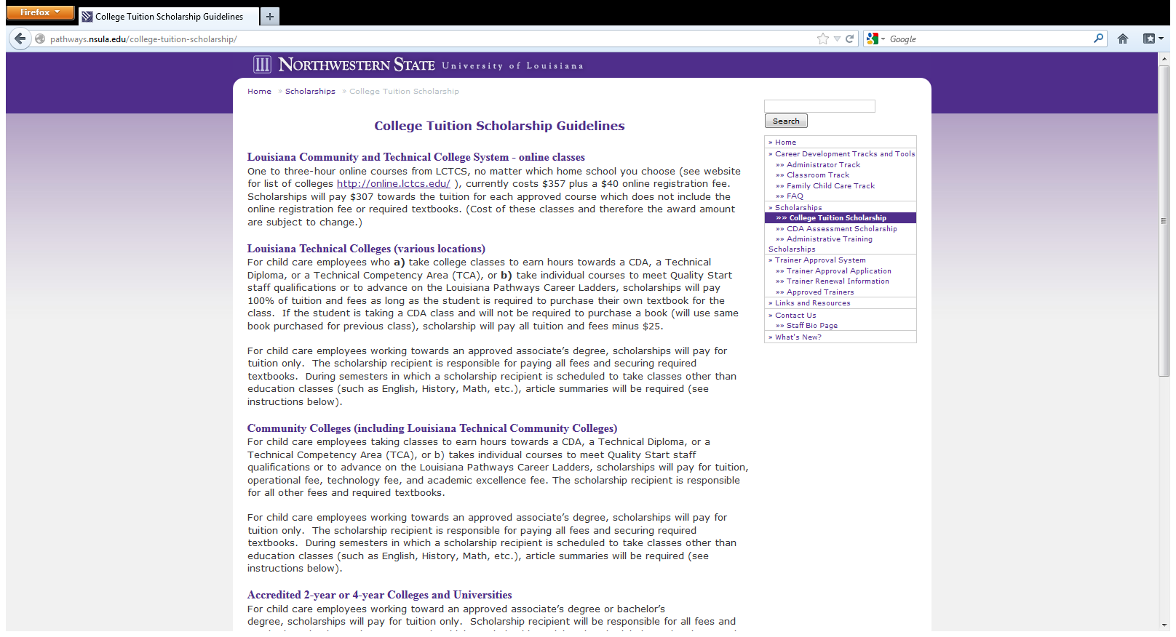
http://pathways.nsula.edu

Slide 32
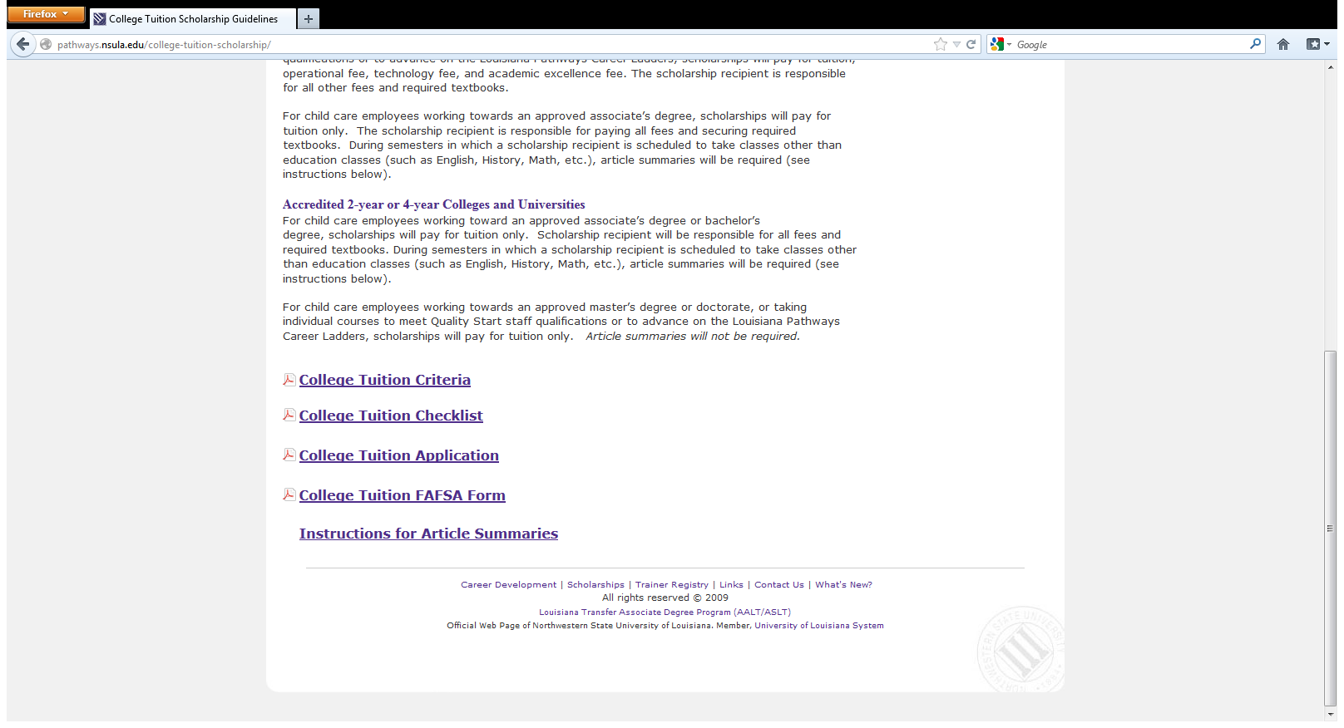
http://pathways.nsula.edu

Slide 33
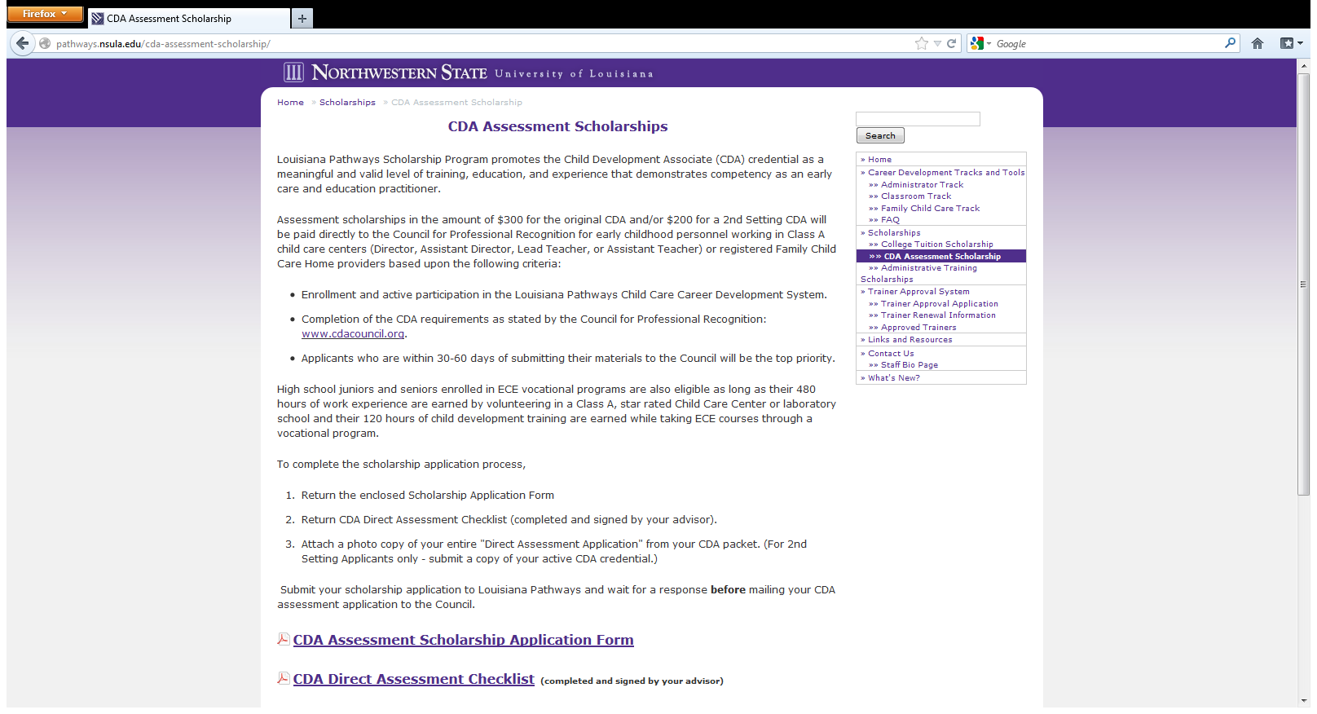
http://pathways.nsula.edu

Slide 34
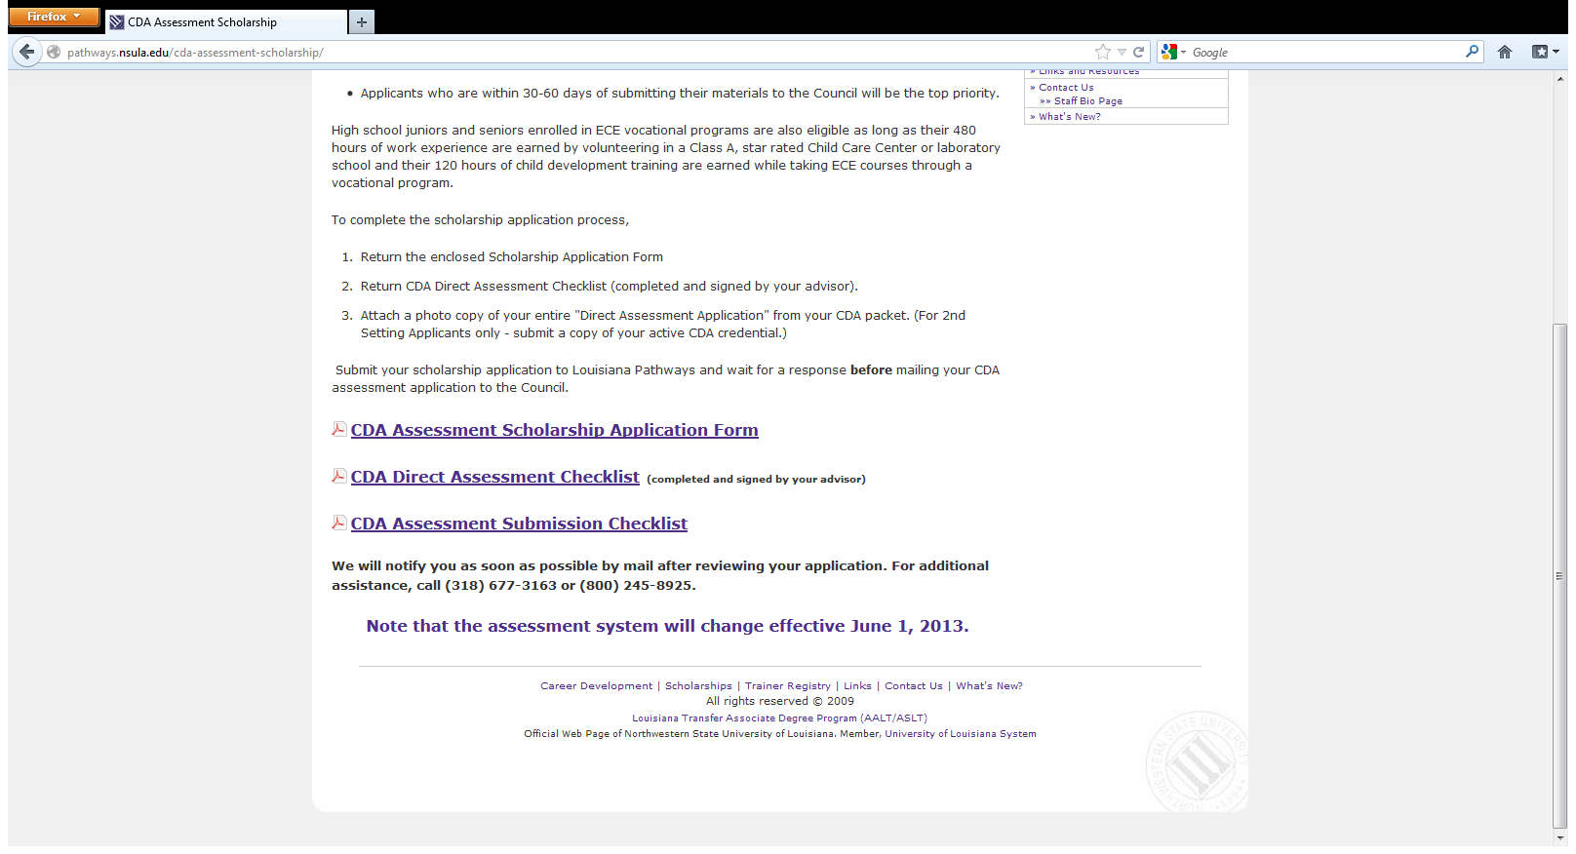
http://pathways.nsula.edu

Slide 35
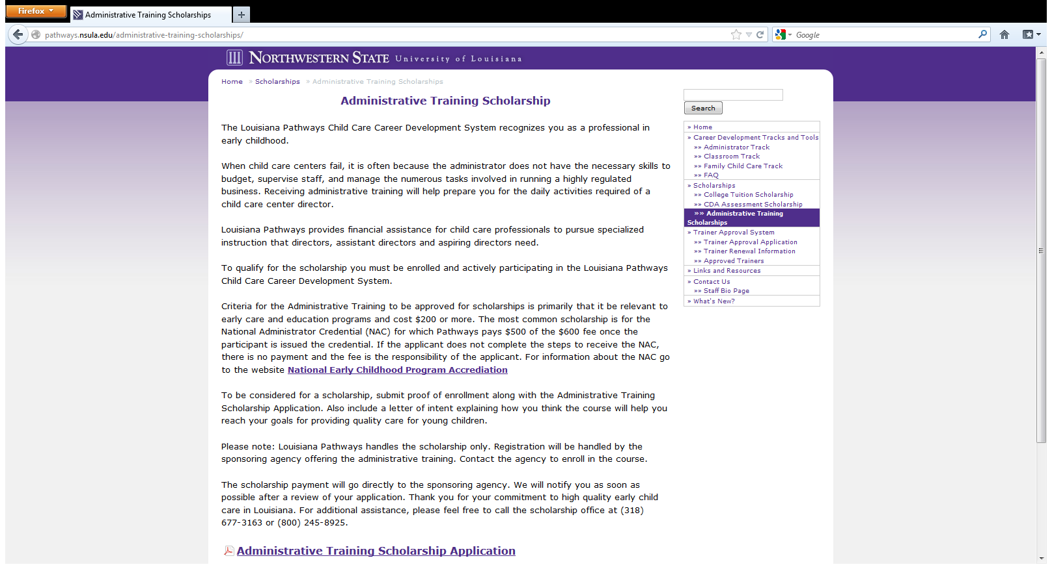
http://pathways.nsula.edu

Slide 36
Trainer Approval
All training used for annual training through licensing must be provided by a Pathways approved trainer.
  Two options for Approval
    FastTrack
    Independent

Slide 37
Trainer Approval
FastTrack
  LDOE System Fast Track Trainers may be any individual who currently meets the employment criteria and whose supervisor/administrator has requested their approval as a requirement of their job.

Slide 38
Trainer Approval
Employment Criteria for FastTrack
School Board Staff or Teachers
LA Department of Education Staff
LA Department of Health and Hospitals staff from one of the following offices: Health Promotions Team,
Bureau of Family Health, Bureau of Primary Care and Rural Health, WIC, or Childrens with Special Health
Care needs
Early Steps Staff/Contractor
Community Network Lead Agency Staff
Trainer/TA for Resource and Referral Agency
Head Start Staff
Consultant from an Approved LDE Contractor
CLASS Special Learner Initiative
Other Initiative/Program Approved by LDE
Representative from Tier I Curriculum Company
Early Childhood Ancillary Certificate Program (BESE Approved)
Director or Assistant Director of a licensed Type III Early Learning Center at Pathways Director I level or
higher (subject to verification)
Lead Teacher at a licensed Type III Early Learning Center at Pathways Teacher I or higher
(subject to verification & recommendation of Director)

Slide 39
Trainer Approval
  If you would like to be approved as a FastTrack
  trainer by Louisiana Pathways, please submit the following information:
  LDOE FastTrack Trainer Application
  Trainer Agreement and Release Form
  CLASS reliability certificates or CLASS Trainer certificates, if applicable.
  TS Gold Trainer or Inter-rater reliability certificates, if applicable.

Slide 40
Trainer Approval
FastTrack
If approved, the trainer will receive a certificate from the
Louisiana Pathways certifying them as Trainer I, II or III based on their documented education and experience as verified by their supervisor/administrator. Subject areas taught are determined
by supervising agency.
The approved trainer will then be included in the Louisiana Pathways Trainer Registry, and will receive a unique Pathways trainer identification number which will be included on the continuing education certificates that he/she provides to attendees.
Initial approval and each renewal will be effective for a
period of 3 years.

Slide 41
Trainer Approval
    Application Process for:
    Independent Trainers
      Complete Trainer Registry Application
      Trainer Agreement and Release Form
      Current Resume’
      Documentation of Educational Background
      (transcripts, copies of credentials)
      Two Trainer Skills Surveys completed by
      people who have observed you training.
      Documentation of completion of “Pathways Trainer Orientation” and “Louisiana's Birth to Five Early Learning and Development Standards”

Slide 42
Trainer Approval
If approved, the trainer will receive a certificate from Louisiana Pathways recognizing the trainer level and approved areas for training (CDA Subject areas). Individuals will be certified as Trainer I, II or III based on their documented education and experience.
The approved trainer will then be included in the Louisiana Pathways Trainer Registry, and will receive a unique Pathways trainer identification number which will be included on the continuing education certificates that he/she provides to attendees.
Initial approval and each renewal will be effective for a period of 3 years.

Slide 43
Trainer Approval
For Independent Trainers only:
Documentation of 9 clock hours of training in adult learning/presentation skills appropriate for training child care personnel is required for renewal.
Note: FastTrack trainers will participate in training in adult learning at the discretion of their supervisor/administrator.

Slide 44
Trainer Approval
Train the Trainer Guidelines
Train the Trainer Presenters must have documented expertise in adult learning and have extensive experience in training adults.
Train the Trainer Topics--Must be relevant to adult learning
  Examples of Accepted Topics
    How to use audio visual aids
    Activities for icebreakers & small groups
    Facilitation skills

Slide 45
Trainer Approval
Train the Trainer Guidelines
  Examples of Accepted Topics
    Programs designed to improve presentation
    Design of training materials or planning & evaluating training
    Sessions to motivate persons to implement new techniques in training sessions
  Examples of Unaccepted Topics
    Train the trainer sessions used to teach content
    How to use a particular curriculum or parent education curriculum
    Sessions designed to improve Director skills

Slide 46
Trainer Approval
Documenting Train the Trainer Hours
  Conferences
    Photocopy of certificate and/or have presenter sign the session description, photocopy of notes/handouts
  ASTD (American Society for Training & Development) Meetings—1 clock hr (not all topics will count)
    Copy of email or brochure with workshop information and photocopy of receipt, copies of notes/handouts
  College Classes
    Transcript or grade report

Slide 47
Trainer Approval
Documenting Train the Trainer Hours
  Toastmasters Meetings—1 clock hr
    Copy of agenda signed by meeting chairperson
  Workshops & seminars
    Copy of Certificates (includes name, date, topic, # hrs, & presenter signature)
  Article Summaries—1 clock hr (maximum of 3 per renewal period)
    Write a 1 page summary of the article, attach copy of article

Slide 48

Thank you for your participation today!
The team at Louisiana Pathways appreciates you and is here to support you!

Slide 49
Contact Information
Phone number: 1-800-245-8925
Website: http://pathways.nsula.edu
Email: Jenny Cowan cowanj@nsula.edu
Additional Contacts:
Donna Tanner (Program Assistant-Career Ladder) tannerd@nsula.edu
Jeanne Thomas (Program Assistant-Career Ladder) thomasje@nsula.edu
Yolanda Hendricks (Program Assistant-CDA Scholarships) hendricksy@nsula.edu
Gaynell Simmons (Data Manager, Trainer Assistant) simmonsga@nsula.edu
Facebook: http://www.facebook.com/lapathways

